Slide 1
MEMO

Slide 2
Introduction
There are four important channels through which information flows within the various sections of an organization:
face-to-face
over telephone
through email
through an inter-office memorandum (in short a memo)
Memos (or memoranda) are written by everyone from junior executives and engineers to Chief Executive Officers.
The message itself may be very simple: ‘Buy more paper clips’ or ‘Meet with President at 2:30’ or ‘We are running out of storage space’.

Slide 3
What is memo?
A business memo is a formal written message, written in a conversational form for someone within the organisation to meet a specific need.
It is a form of dialogue, where the writer wants to say something and expects a response to the message.
It is an important means of internal communication used to send information inside an organisation.

Slide 4
Letters Versus Memos
Unlike letters, which are used as a means to reach out to people outside an organisation, memos are used to send information inside an organisation. A memo is written in a specific format, which is different from the letter format.
Memos are less formal than letters.
Memos are less structured than letters.
The tone of memo is more conversational than that of a letter.
Memos contain less background explanation and information than letters.

Slide 5
Uses of Memos
1. To request for action or information. This allows one to have a written record of the request. As compared with an oral request, this type of written request is more difficult for the audience to forget or ignore.
2. To explain to the reader something that is not understood. The purpose in this case is to clarify something to the reader.
3. To announce or to give formal notice to readers, publicly informing them about new procedures, new products, or anything that needs to be publicly known.

Slide 6
Uses of Memo
4. To confirm the details of a meeting, conversation, or telephone call. This would enable one to have a written record of decisions or agreements that were made.
5. To suggest solutions to business problems, to offer one’s services or those of the department, or to bring up new ideas or methods of doing things.
6. To report the details of a project at regular intervals as a way of helping the organization keep track of progress and problems.
7. To appreciate the achievements of the employees.
8. To warn the employees.

Slide 7
Classification
To write effective memos, one has to keep in mind the purpose of writing the memo and the readers’ interest.
Depending on their purpose, memos can be classified into three major categories:
1. Documentary
2. Congratulatory
3. Disciplinary

Slide 8
1. Documentary memos
As the name suggests, these memos are mainly used for conveying information, such as
Memos written to a subordinate
to remind
to announce
to give instructions
to explain a policy or procedure
Memos written to a peer or superior
to make a request or routine recommendation
to confirm an agreement
For instance, a memo explaining the new method of maintaining medical records of employees in an organization.

Slide 9
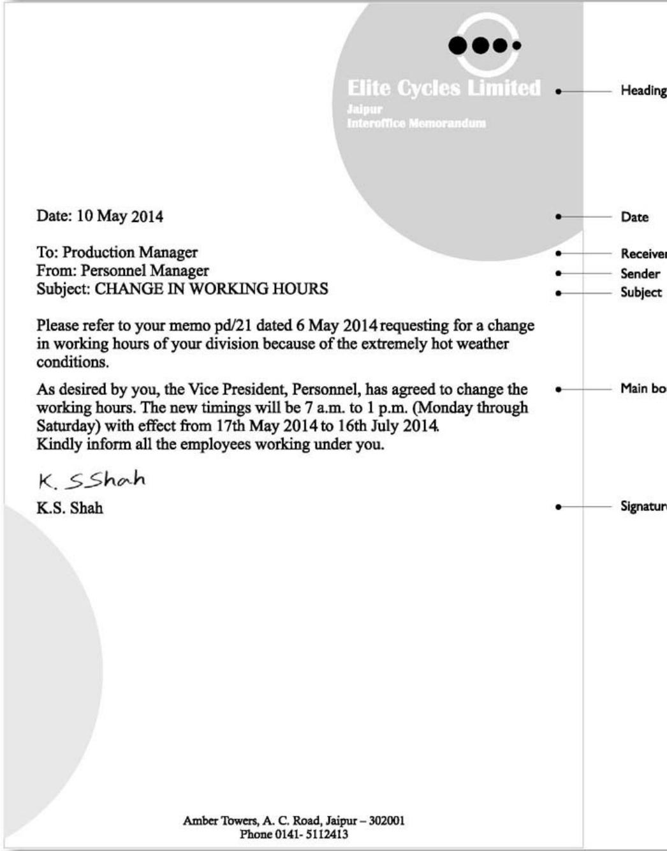
Sample Documentary Memo

Slide 10
2. Congratulatory memos
Memos are also used to give credit to employees of an organization for the outstanding work they have accomplished.
Example:
It is appropriate for the Vice Chancellor of a university to send a memo to the faculty members congratulating their outstanding contribution to the field of research.
Employees can also send their compliments in the form of a memo to their officers, for the awards or achievements that the latter may have earned.

Slide 11
3. Disciplinary memos
When employees violate the rules or breach the code of conduct in an organization, they will be served either with a severe warning or any other punishment as decided by the management. The memo conveying this action is known as a disciplinary memo.
For instance, a memo may be issued to an officer who has accepted a bribe from one of the customers.

Slide 12
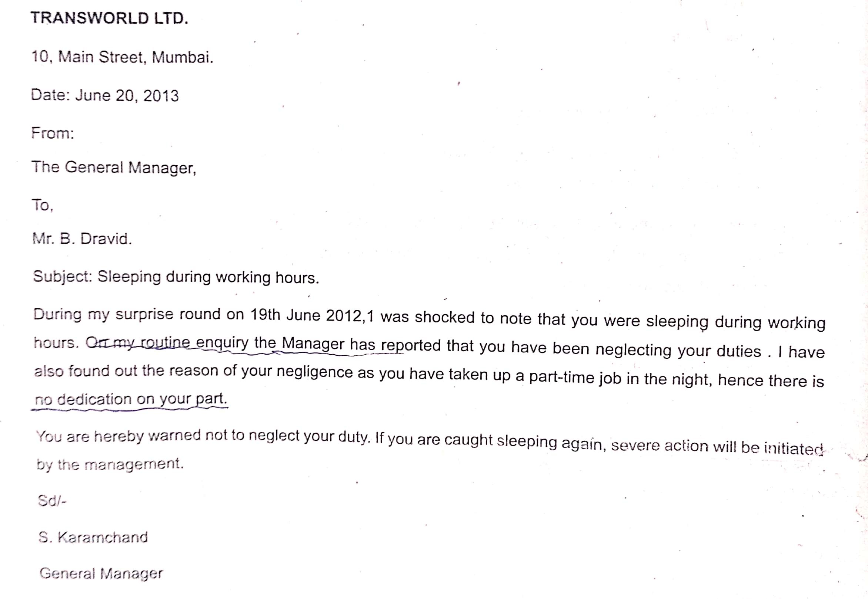

Slide 13
Structure and Layout
Standard memos are divided into five main segments to organize information and to help achieve the writer’s purpose.
However, depending on the requirements, we may need to add two more segments, one for attachments and the other for distribution of copies.
Heading
Opening
Discussion
Closing
Signature
Necessary Attachments (optional)
Distribution (optional)
Organizations generally provide printed memo forms to their various divisions, which contain all the segments mentioned above.

Slide 14
Heading
The heading segment follows this general format:
Name of the organization and address (Printed Letterhead)
Date: (Complete and current date)
To: (Designation of the recipient)
From: (Designation of the sender)
Subject: (What the memo is about, highlighted in some way)
Since memos are used for communication within the organization, it is enough if the designations of the sender and the recipient are mentioned against To and From in the layout.

Slide 15
Heading- Subject
Almost every recipient reads the subject line, which gives a clear idea of the topic discussed in the memo.
The subject line, usually typed in capitals, communicates to the reader(s), the purpose of the memo. One-word subject lines do not communicate effectively, as in the following flawed subject line.
Subject: SUPERVISORS
Such a subject line gives a vague idea about the contents of the memo, and lacks focus. A better subject line for this would be:
Subject: SALARY INCREASE FOR SUPERVISORS

Slide 16
Opening
The purpose of a memo is usually found in the opening paragraphs and is presented in three parts:
1. the context and problem
2. the specific assignment or task
3. the purpose of the memo.
The context is the event, circumstance, or background of the problem being resolved or the topic handled in the memo.
The first paragraph establishes the background.
State the problem or simply the opening of a sentence, such as, ‘In our effort to reduce the absenteeism in our Division ....’
Include only what your reader needs, but be sure it is clear.

Slide 17
Opening
If the action was requested, the task may be indicated by a sentence opening such as, ‘You asked that I look at ....’
To explain our intentions, we might say, ‘To determine the best method of controlling the percentage of absenteeism, I took recourse to three methods ....’
Finally, the purpose statement of a memo gives the reason for writing it and forecasts what is in the rest of the memo. Make sure that this statement is forthright and explains to the reader exactly what is in store.
For example, we might say: ‘This memo presents a description of the current situation, some proposed alternatives, and my recommendations.’

Slide 18
Opening
For instance, the introductory paragraph of a memo from the Manager of the Training Division of a company to the Vice President of that company may contain the following few lines:
As directed by you in your memo dated 21 July 2014, I analysed the possibilities of offering a three-week training programme to our supervisors. I am submitting my views on organizing this programme in the lines that follow:

Slide 19
Discussion
The discussion segment is the part where we develop the arguments that support our ideas. For example, if a memo is being written to a superior who has asked for an analysis of the feasibility of offering some new services to employees, the details of the analysis can be explained in this section.
If one has to direct a subordinate to conduct a survey on the effectiveness of the new machines introduced in the division, the specific details regarding the aspects that need to be examined can be mentioned in this segment. Since very few readers read every line of the memos they receive, keep the communication brief.

Slide 20
Closing
A memo can end with some complimentary remarks or directive statements. While a complimentary close motivates the readers and makes them feel happy, a directive close tells them what exactly is to be expected or what they have to do next.
Example:Complimentary Close
If our results continue to improve at this rate, we will attract more students during the coming years. Congratulations!
Example: Directive Closing
I would like to resolve the issue only after hearing from you. Hence, kindly inform me before 25 August 2021.

Slide 21
Necessary attachments
Make sure all findings are documented to provide detailed information whenever necessary. This can be achieved by attaching lists, graphs, tables, etc. at the end of the memo. Be sure to refer to the attachments in the memo and add a notation about what is attached below the closing, like this:
Attached: Director’s approval letter
Attached: Several Complaints about Product, January–June 2014
Attached: List of absentees on 17 July 2014

Slide 22
Distribution
This last segment is used to mention the designations of those people to whom a copy of the memo has been sent.
This segment is not mandatory in a memo. The short form of complimentary copy, that is, Cc, can also be used instead of the word distribution:
Distribution:
Assistant Manager, Operations
Supervisor, Manufacturing

Slide 23
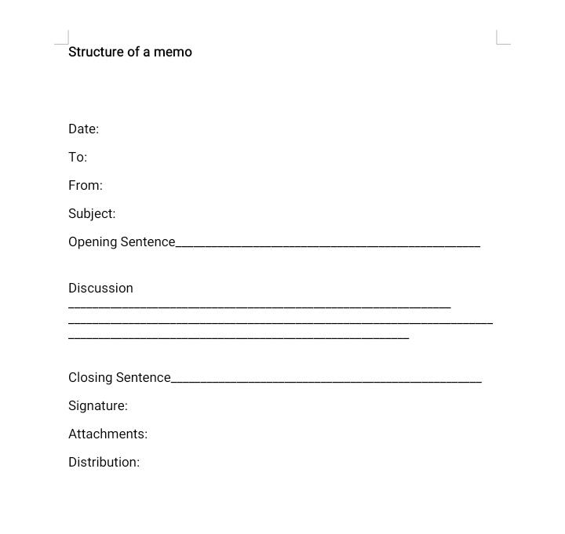

Slide 24
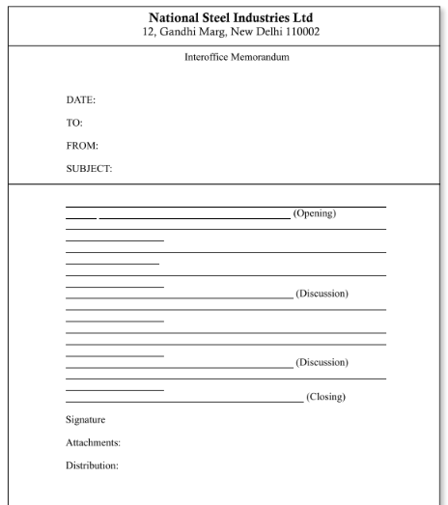

Slide 25
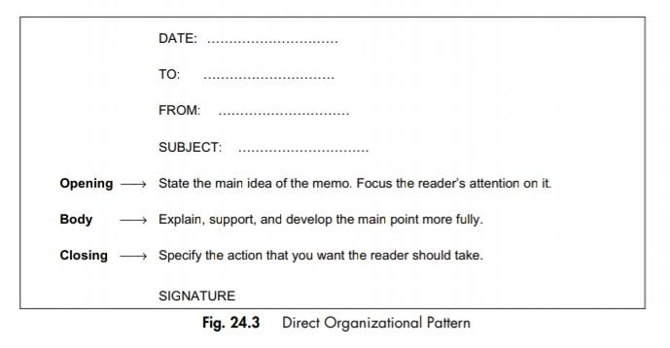
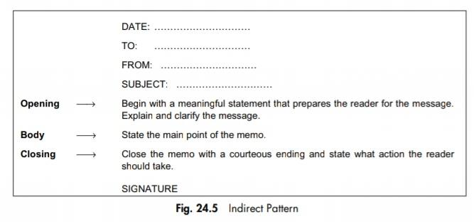

Slide 26
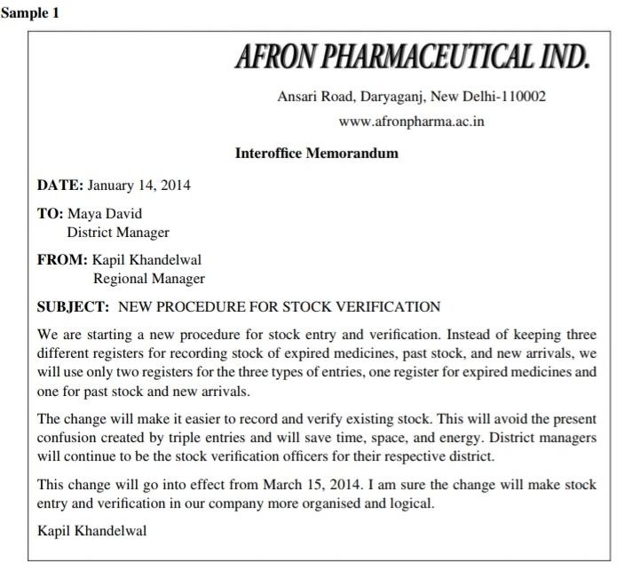
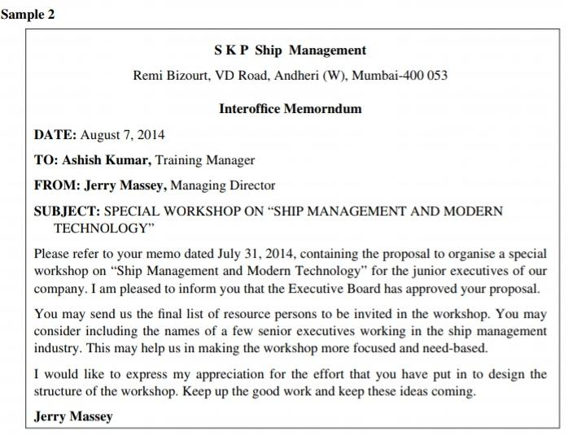

Slide 27
